Slide 1
EXCEL PROJECT on IPL 2008-2021 Data Set
Prepared BY :- ANIKET Rajendra shoste
( Board infinity )

Slide 2
OVERVIEW
THIS PROJECT IS BASED ON IPL FROM 2008 – 2021 , AS PER SEASON GIVEN IN THE DATA SET ,GOT SOME VALUABLE INSIGHTS AND BELOW IS SOME INFORMATION ABOUT DATA.
THIS DATASET CONSIST OF 18 COLUMNS & 1866 ROWS.
FROM THIS DATASET ,THE FIELDS WHICH ARE USED AS FOLLOWS :-
Season , City, Date , Team1, Team2 ,Toss winner, Toss decision, Result ,dl applied ,Winner, Win by runs, Win by wickets ,Player of match ,Venue, Umpire1 Umpire 2, Umpire3 ,Player name , Total runs , Number of balls played, and out ,Average , Strike rate ,Player Name , DOB, Batting Hand ,Bowling Skill ,Country ,Home & Away Matches.

Slide 3
QUESTIONS BASED ON DATASET
Which City Played the most number of matches .
Total number of Matches Played Per Season in IPL .
Total Matches Played and Win by the Teams In IPL .
Respected Winning Team by making Toss Decision as Bat or Field .
Analyzing the dependency of Toss Win towards match Win .
Which Venue conducted most Matches Played in IPL .
Number of Matches Win by Teams Per Season in IPL.
Chances of winning if the Team is playing in "Home or Away " Ground .
Best Performing Teams In IPL .
Total number of Players playing for their Country & which Age group they Lie .
Batting & , Bowling Players in respected Country with their skills.
Most Top 10 "Player of the Match " / " Man of the Match " award Win in IPL .
Top 10 " Power Hitters " Batsmen of the IPL with their strike rate and average .

Slide 4
Which City Played the most number of matches .
Mumbai =114 ,Kolkata = 78 ,Delhi = 74

Slide 5
Total number of Matches Played Per Season in IPL
2013 ,2011,2012 IPL most of the matches were conducted

Slide 6
Total Matches Played by each Team in IPL
MI , KKR , RCB , CSK played most matches in IPL

Slide 7
Respected Winning Team by making Toss Decision as Bat or Field
Analyzing the dependency of Toss Win towards match Win

Slide 8
Which Venue conducted most Matches Played in IPL
Wankhede and Eden Gardens Stadium most matches were played

Slide 9
Number of Matches Win by Teams Per Season in IPL

Slide 10
Total Matches Win In IPL
Mumbai Indians , Chennai Super Kings , are the most winning Teams in IPL

Slide 11
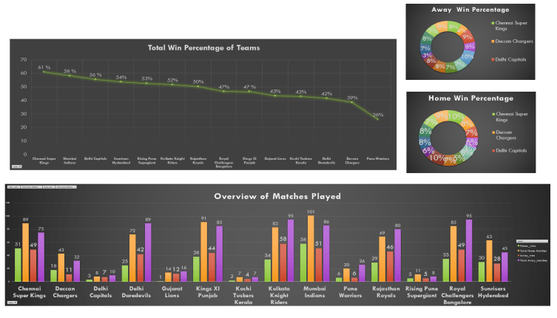
Chances of winning if the Team is playing in "Home or Away " Ground

Slide 12
Best Performing Teams In IPL

Slide 13
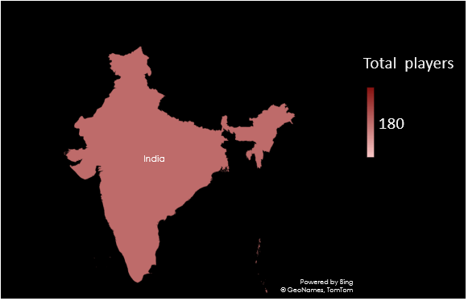
Total number of Players playing for their Country
& which Age group they Lie

Slide 14
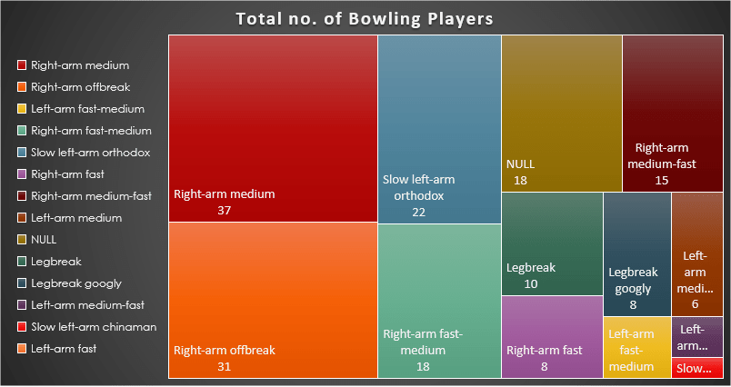
Batting & , Bowling Players in respected Country with their skills.

Slide 15
Most Top 10 "Player of the Match " award Win in IPL
with the Respected Player
CH Gayle , AB de Villiers won the most player of the match tittle

Slide 16
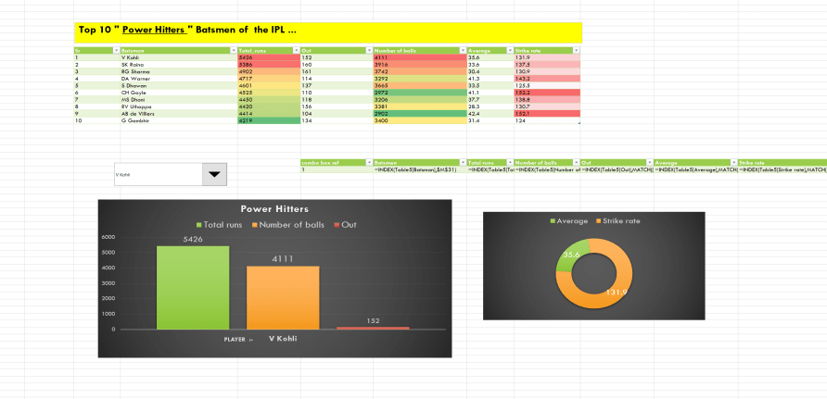
Top 10 " Power Hitters " Batsmen of the IPL ...

Slide 17
CONCLUSION
FROM THE DATA SET, IT IS EVIDENT THAT :-
Mumbai ,Kolkata & Delhi are the cities were most of the matches were played .
2013 ,2011,2012 were the Seasons in IPL where most of the matches were conducted .
MI , KKR , RCB , CSK played most matches in IPL .
Wankhede and Eden Gardens Stadium most matches were played .
CH Gayle , AB de Villiers won the most player of the match tittle .
Virat Kohli is in the 1st position of Power Hitters as he had made 5426 runs in 4111 balls and been Out 152 times and his average is 35.6 and Strike rate is 131.9 .
Mumbai Indians , Chennai Super Kings , are the most winning and Best Performing Teams in IPL .
We also Analyze the Toss win = Match win Dependency with the Toss Decision in every Season of IPL.
We also get to know the Total number of players playing from the country as Skill wise with their Age group .

Slide 18
SOURCE DATA
DATASET
https://www.kaggle.com/ramjidoolla/ipl-data-set
VIDEO PRESENTATION LINK
Drive video link :- https://drive.google.com/file/d/175fAZ6tRxtuJGd5vZp7K_S82Cc8Z-kzn/view?usp=sharing
Youtube link :-https://www.youtube.com/watch?v=yPvVp6wQtqA
Drive all files link :-
//drive.google.com/drive/folders/1_b3yG-9CB4wisKxWMT8EkyNARS0MKwZy?usp=sharing

Slide 19
DYNAMIC DASHBOARD
“ IPL -1,2,3 ”

Slide 20
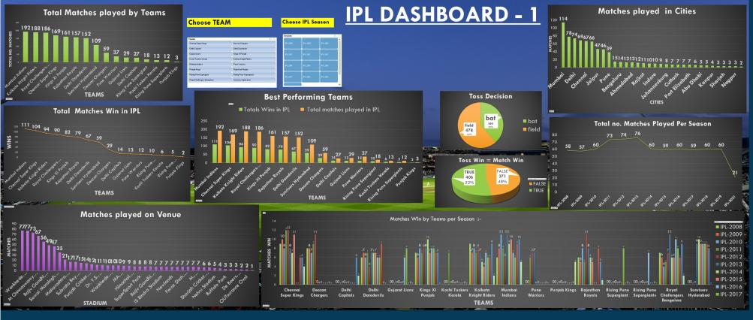
Dynamic IPL Dashboard

Slide 21
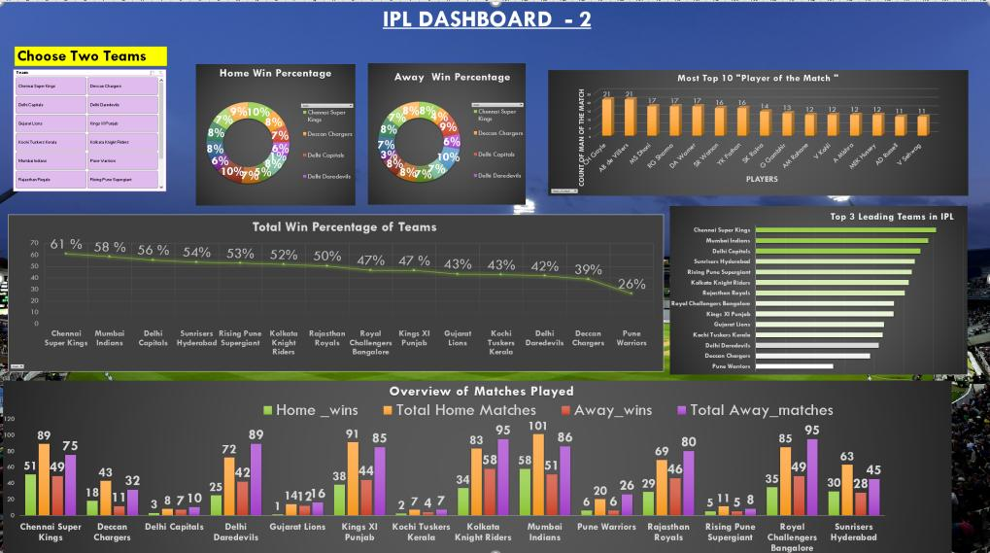

Slide 22
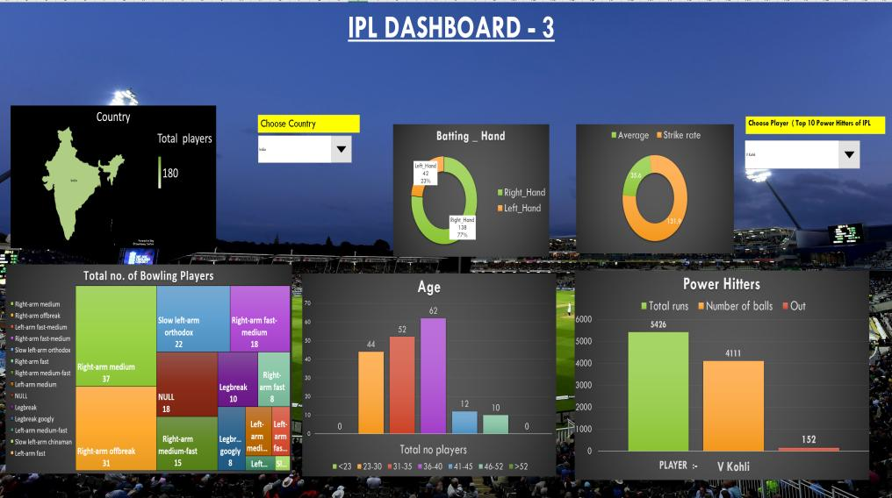

Slide 23
THANK YOU

